Slide 1
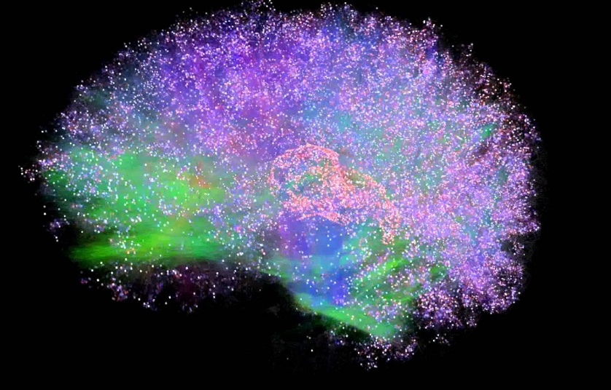
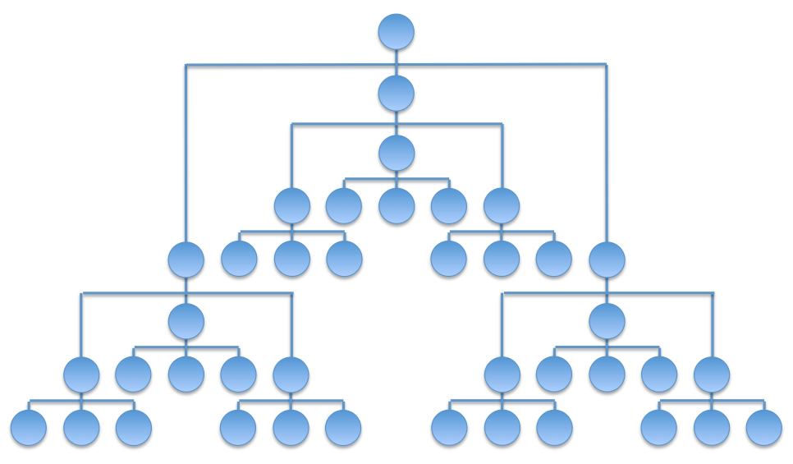
Integrated Information Theory for Organisational Consciousness
Jonathan Peters
Supervisors: Mariano Beguerisse, Christian Bick, Yakov Kremnitzer, Steve Brewis, Steve Cassidy

Slide 2
Integrated Information Theory
Properties of Consciousness
Existence
Composition
Integration
Information
Exclusion
RED

Slide 3
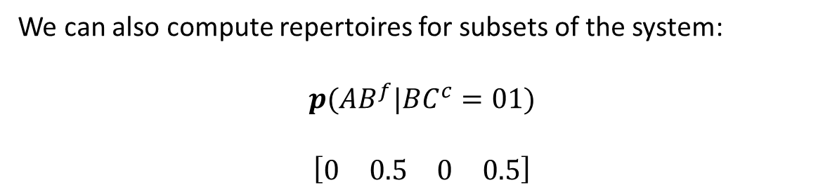

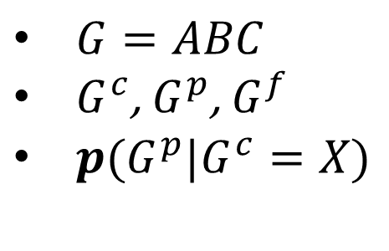
Notation
A
Or
$G=ABC$
$G^{c}$, $G^{p}$, $G^{f}$
$p(G^{p}|G^{c}=X)$
B AND
C
XOR
For example,
$$p(G^{f}|G^{c}=100)$$
$$\left[\begin{matrix}0 & 0 & 0 & 0 & 1 & 0 & 0 & 0\end{matrix}\right]$$
$$\left[\begin{matrix}000 & 100 & 010 & 110 & 001 & 101 & 011 & 111\end{matrix}\right]$$
We can also compute repertoires for subsets of the system:
$$p({AB}^{f}|{BC}^{c}=01)$$
$$\left[\begin{matrix}0 & 0.5 & 0 & 0.5\end{matrix}\right]$$

Slide 4
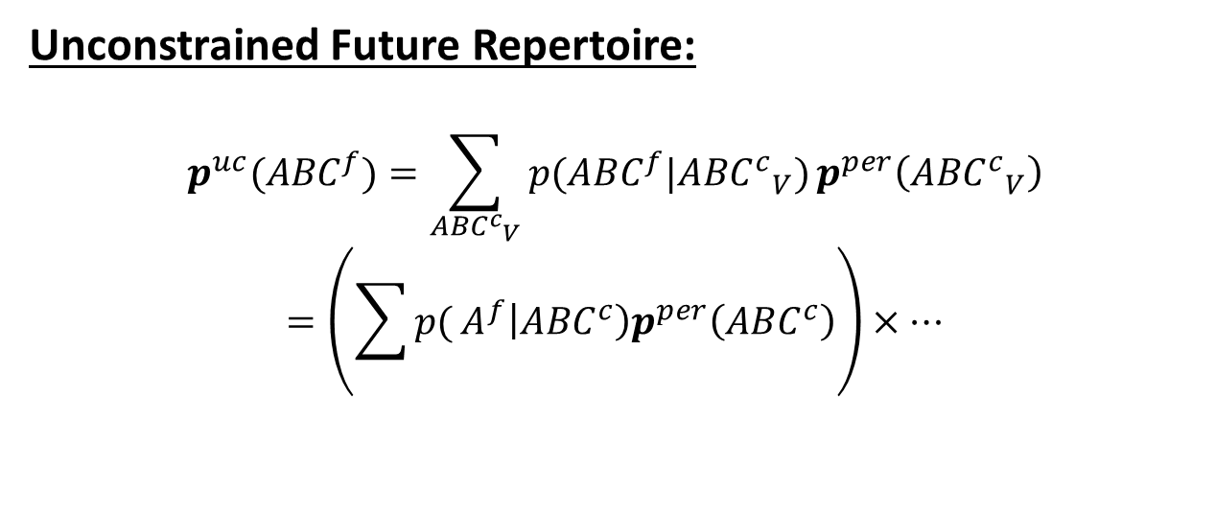
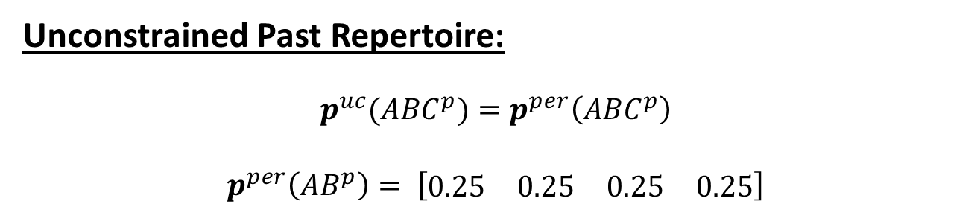
Unconstrained repertoires
Unconstrained Past Repertoire:
$$p^{uc}({ABC}^{p})=p^{per}\left({ABC}^{p}\right)$$
$$p^{per}\left({AB}^{p}\right)= \left[\begin{matrix}0.25 & 0.25 & 0.25 & 0.25\end{matrix}\right]$$
Unconstrained Future Repertoire:
$$p^{uc}({ABC}^{f})=\sum_{{{ABC}^{c}}_{V}}{p({ABC}^{f}|{{ABC}^{c}}_{V})}p^{per}\left({{ABC}^{c}}_{V}\right)$$
$$=\left(\sum{p(}A^{f}\left|{ABC}^{c}\right)p^{per}\left({ABC}^{c}\right)\right)×…$$

Slide 5
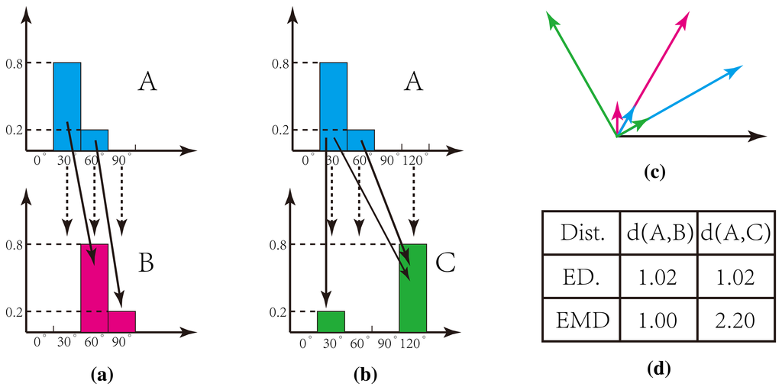
Earth Mover’s Distance

Slide 6
Mechanisms
A Or
B And
C Xor
Existence: The mechanism ABC exists.
Composition: The mechanism ABC is the composition of 3 smaller mechanisms: a 3rd order mechanism.

Slide 7
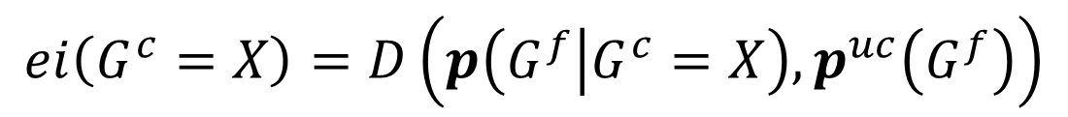
Information
Unconstrained Present
Known Present State
Unconstrained Future
Effect Repertoire
$$ei\left(G^{c}=X\right)=D\left(p\left(G^{f} | G^{c}=X\right), p^{uc}\left(G^{f}\right)\right)$$

Slide 8
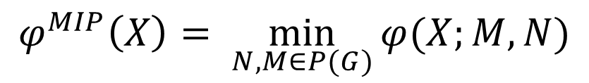

Integration
$${ABC}^{c}/{ABC}^{f}$$
A
A
A
A
B
B
VS
B
B
C
C
C
C
$$φ\left(X;M,N \right)=D\left(p\left(G^{f} | G^{c}=X\right),p\left(M^{f} | N^{c}=X_{N}\right)∗p\left({G\backslash M}^{f} | {G\backslash N}^{c}=X_{G\backslash N}\right)\right)$$
$$φ^{MIP}\left(X\right)= \min_{N,M∈P(G)}{φ(X;M,N)}$$

Slide 9

Exclusion
What is the core effect of ${AB}^{c}=01$?
A
A
B
B
C
C
Calculate $φ^{MIP}(01)$ for ${AB}^{c}/M^{p}$ for all $M∈P(G)$
The largest value of $φ^{MIP}(01)$ gives $φ^{MAX}\left(01\right).$

Slide 10
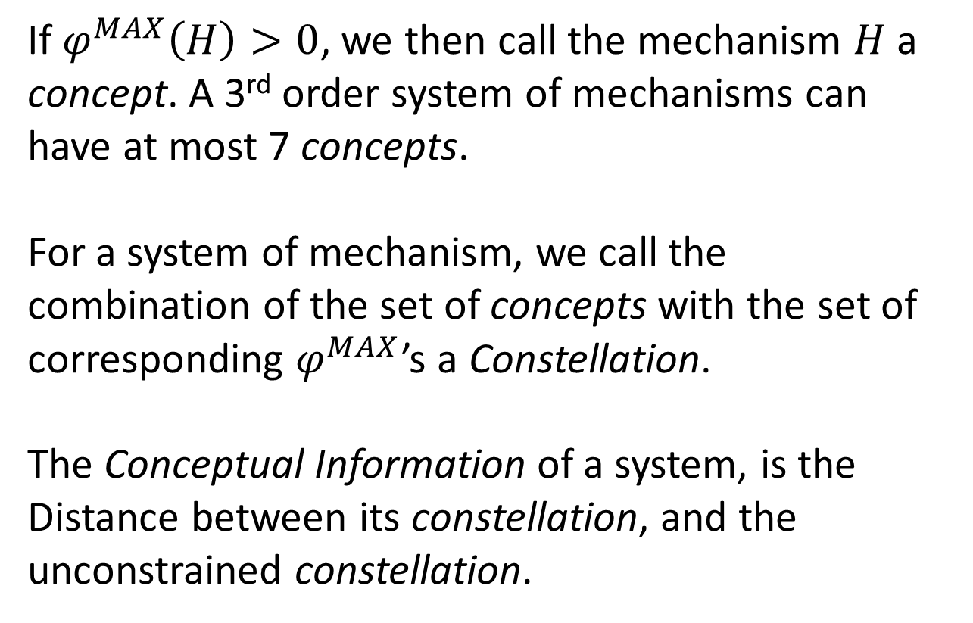
Further Calculations
If $φ^{MAX}\left(H\right)>0$, we then call the mechanism $H$ a concept. A 3rd order system of mechanisms can have at most 7 concepts.
For a system of mechanism, we call the combination of the set of concepts with the set of corresponding $φ^{MAX}$’s a Constellation.
The Conceptual Information of a system, is the Distance between its constellation, and the unconstrained constellation.

Slide 11
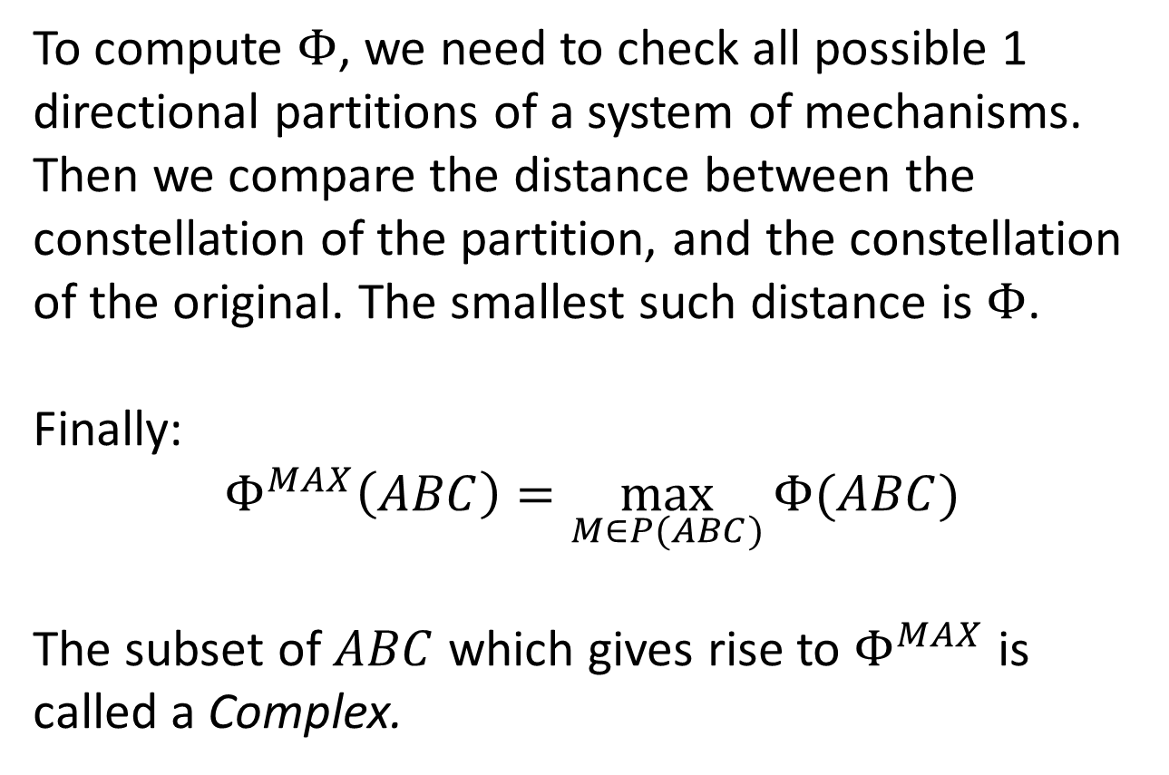
Further Calculations
To compute $Φ$, we need to check all possible 1 directional partitions of a system of mechanisms. Then we compare the distance between the constellation of the partition, and the constellation of the original. The smallest such distance is $Φ$.
Finally:
$$Φ^{MAX}\left(ABC\right)=\max_{M∈P(ABC)}{Φ(ABC)}$$
The subset of $ABC$ which gives rise to $Φ^{MAX}$ is called a Complex.

Slide 12


Computation of $Φ$
Pre-existing software exists to compute $Φ$.
$$T_{ij}=P(G^{t+1}=j|G^{t}=i)$$
ABC | 000 | 100 | 010 | 110 | 001 | 101 | 011 | 111
000 | 1 | 0 | 0 | 0 | 0 | 0 | 0 | 0
100 | 0 | 0 | 0 | 0 | 1 | 0 | 0 | 0
010 | 0 | 0 | 0 | 0 | 0 | 1 | 0 | 0
110 | 0 | 1 | 0 | 0 | 0 | 0 | 0 | 0
001 | 0 | 1 | 0 | 0 | 0 | 0 | 0 | 0
101 | 0 | 0 | 0 | 0 | 0 | 0 | 0 | 1
011 | 0 | 0 | 0 | 0 | 0 | 1 | 0 | 0
111 | 0 | 0 | 0 | 1 | 0 | 0 | 0 | 0

Slide 13
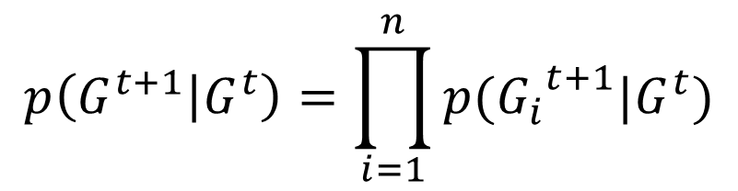

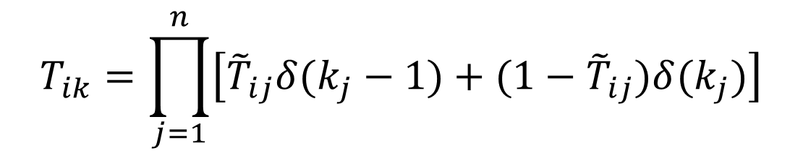
Transition Probability Matrix
$$p\left(G^{t+1} | G^{t}\right)=\prod_{i=1}^{n}{p({G_{i}}^{t+1}|G^{t})}$$
State | A | B | C
000 | 0 | 0 | 0
100 | 0 | 0 | 1
010 | 1 | 0 | 1
110 | 1 | 0 | 0
001 | 1 | 0 | 0
101 | 1 | 1 | 1
011 | 1 | 0 | 1
111 | 1 | 1 | 0
$${\tilde{T}}_{ij}=P({G_{j}}^{t+1}=1|G^{t}=i)$$
$$T_{ik}=\prod_{j=1}^{n}{\left[{\tilde{T}}_{ij}δ(k_{j}−1)+(1−{\tilde{T}}_{ij})δ(k_{j})\right]}$$

Slide 14
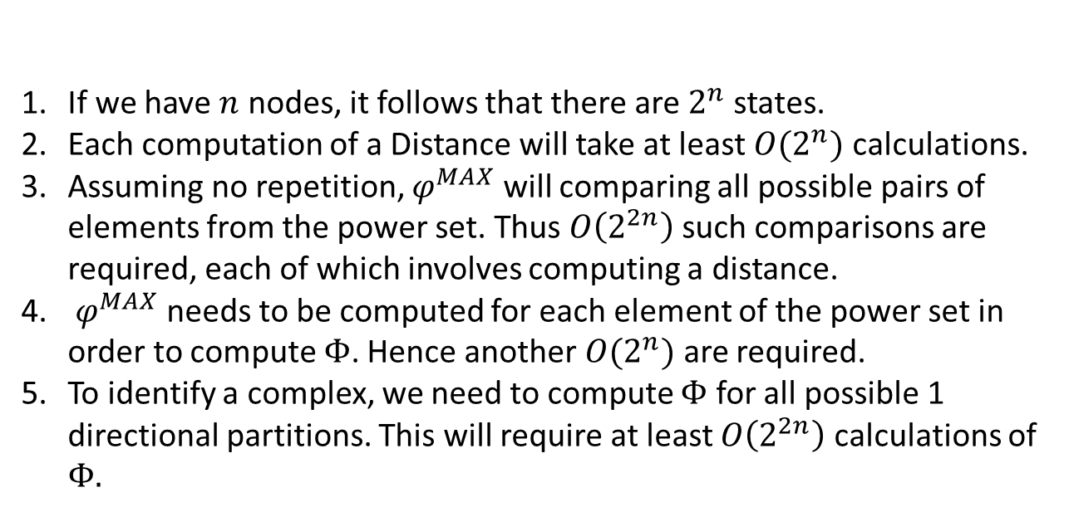

Scalability of $Φ$
If we have $n$ nodes, it follows that there are $2^{n}$ states.
Each computation of a Distance will take at least $O(2^{n})$ calculations.
Assuming no repetition, $φ^{MAX}$ will comparing all possible pairs of elements from the power set. Thus $O\left(2^{2n}\right)$ such comparisons are required, each of which involves computing a distance.
$φ^{MAX}$ needs to be computed for each element of the power set in order to compute $Φ$. Hence another $O(2^{n})$ are required.
To identify a complex, we need to compute $Φ$ for all possible 1 directional partitions. This will require at least $O\left(2^{2n}\right)$ calculations of $Φ.$
Hence we estimate $Φ$ scales with at least $O\left(2^{6n}\right)$.

Slide 15
Model
Properties of the Organisation
Profits are made by completing projects. These projects require the application of certain skills in order to be completed.
Each team/individual within the company possesses at least one skill.
Projects are completed once sufficiently many teams/individuals, which possess all required skills, work on the project for a sufficient length of time.

Slide 16
Simple Model
Assumptions
The number of teams/individuals available is fixed.
The skills possessed by each team/individual are fixed.
With each time-step, a single new project arrives. The skills required by this project are randomly determined.
A
α
Pα
C
Pβ
β
B
Skills
Teams
Projects

Slide 17
Simple Model
A
α
Pα
C
Pβ
β
B
Skills
Teams
Projects
Node Pα is on if an incoming project requires skill α.
Node Pβ is on if an incoming project requires skill β.
How should teams A, B and C activate and deactivate?

Slide 18
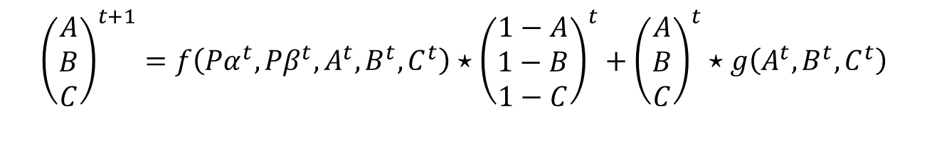
Simple Model
A
α
Pα
C
Pβ
β
B
Skills
Teams
Projects
$${\left(\begin{matrix}A \\ B \\ C\end{matrix}\right)}^{t+1}=f\left({Pα}^{t},{Pβ}^{t},A^{t},B^{t},C^{t}\right)⋆{\left(\begin{matrix}1−A \\ 1−B \\ 1−C\end{matrix}\right)}^{t}+{\left(\begin{matrix}A \\ B \\ C\end{matrix}\right)}^{t}⋆g\left(A^{t},B^{t},C^{t}\right)$$
Node turns on
Node turns off

Slide 19
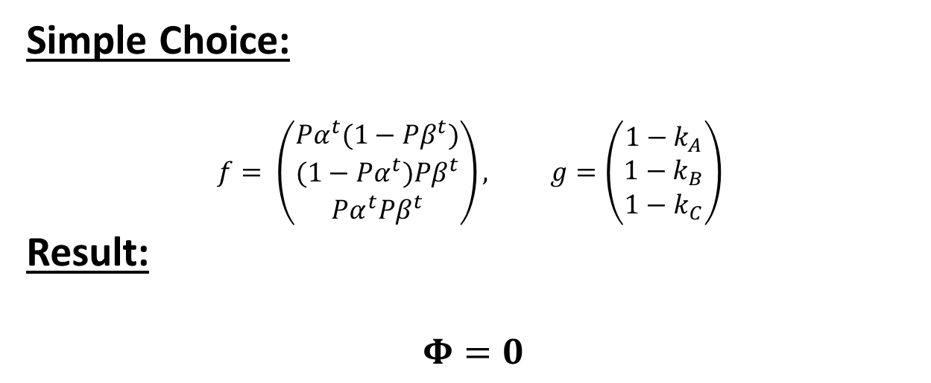
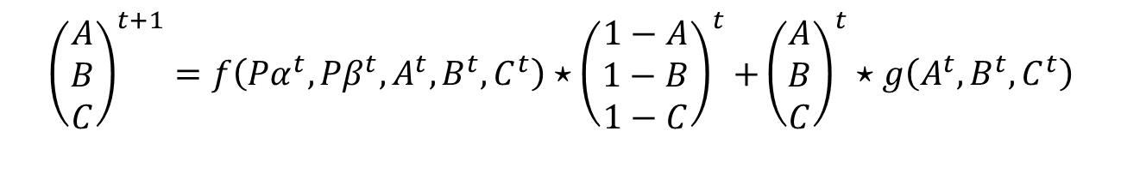
Simple Model
$${\left(\begin{matrix}A \\ B \\ C\end{matrix}\right)}^{t+1}=f\left({Pα}^{t},{Pβ}^{t},A^{t},B^{t},C^{t}\right){⋆\left(\begin{matrix}1−A \\ 1−B \\ 1−C\end{matrix}\right)}^{t}+{\left(\begin{matrix}A \\ B \\ C\end{matrix}\right)}^{t}⋆g\left(A^{t},B^{t},C^{t}\right)$$
Node turns on
Node turns off
Simple Choice:
$$f= \left(\begin{matrix}{Pα}^{t}(1−{Pβ}^{t}) \\ {(1−Pα}^{t}){Pβ}^{t} \\ {Pα}^{t}{Pβ}^{t}\end{matrix}\right), g=\left(\begin{matrix}1−k_{A} \\ 1−k_{B} \\ 1−k_{C}\end{matrix}\right)$$
Result:
$$Φ=0$$

Slide 20
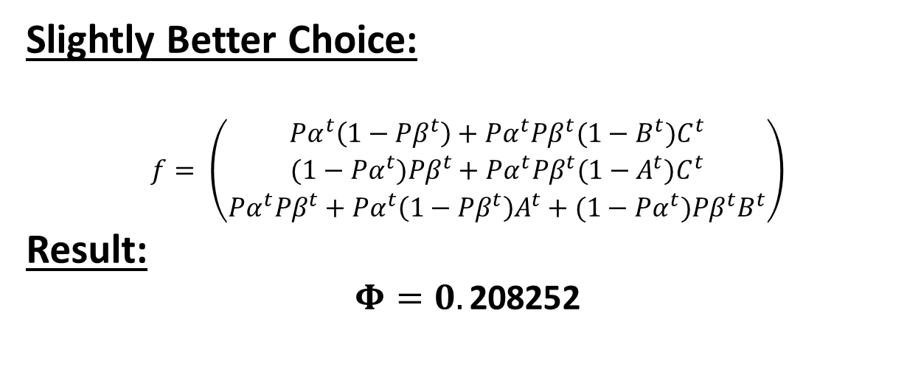
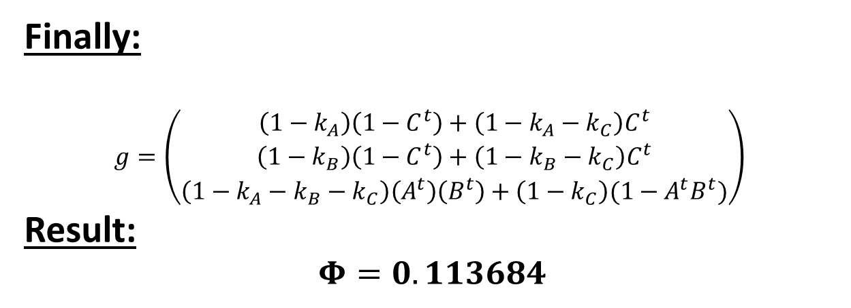
Simple Model
Slightly Better Choice:
$$f= \left(\begin{matrix}{Pα}^{t}\left(1−{Pβ}^{t}\right)+{Pα}^{t}{Pβ}^{t}{(1−B^{t})C}^{t} \\ {(1−Pα}^{t}){Pβ}^{t}+{Pα}^{t}{Pβ}^{t}{(1−A^{t})C}^{t} \\ {Pα}^{t}{Pβ}^{t}+{Pα}^{t}\left(1−{Pβ}^{t}\right)A^{t}+{(1−Pα}^{t}){Pβ}^{t}B^{t}\end{matrix}\right)$$
Result:
$$Φ=0.\text{208252}$$
Finally:
$$g=\left(\begin{matrix}\left(1−k_{A}\right)\left(1−C^{t}\right)+\left(1−k_{A}−k_{C}\right)C^{t} \\ \left(1−k_{B}\right)\left(1−C^{t}\right)+\left(1−k_{B}−k_{C}\right)C^{t} \\ \left(1−k_{A}−k_{B}−k_{C}\right)\left(A^{t}\right)\left(B^{t}\right)+\left(1−k_{C}\right)({1−A}^{t}B^{t})\end{matrix}\right)$$
Result:
$$Φ=0.113684$$

Slide 21
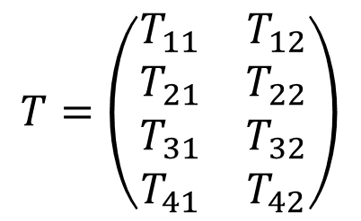
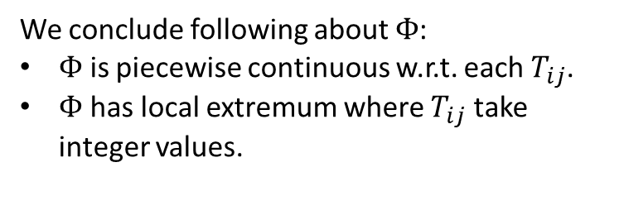
IIT in a 2 node system
A
B
We identify for each 2 node system a unique $4×2$ matrix.
We conclude following about $Φ$:
$Φ$ is piecewise continuous w.r.t. each $T_{ij}$.
$Φ$ has local extremum where $T_{ij}$ take integer values.
$$T=\left(\begin{matrix}T_{11} & T_{12} \\ T_{21} & T_{22} \\ T_{31} & T_{32} \\ T_{41} & T_{42}\end{matrix}\right)$$

Slide 22

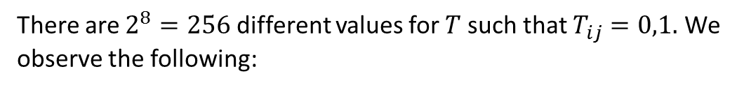
IIT in a 2 node system
Exhaustive Search
There are $2^{8}=256$ different values for $T$ such that $T_{ij}=0,1.$ We observe the following:
00
01
$$Φ=1.5$$
10
11

Slide 23
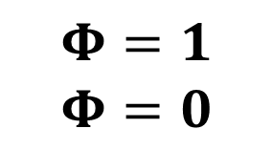
IIT in a 2 node system
00
01
$$Φ=1$$
$$Φ=0$$
10
11
A
!Copy
Reducible
B
Xor

Slide 24
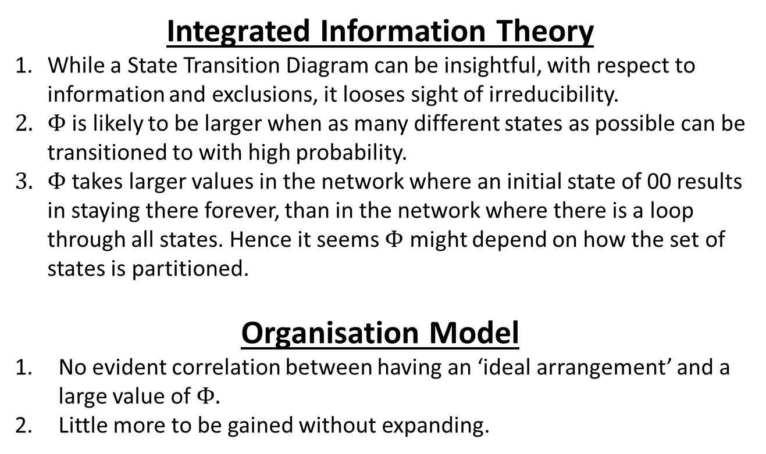
Conclusions
Integrated Information Theory
While a State Transition Diagram can be insightful, with respect to information and exclusions, it looses sight of irreducibility.
$Φ$ is likely to be larger when as many different states as possible can be transitioned to with high probability.
$Φ$ takes larger values in the network where an initial state of 00 results in staying there forever, than in the network where there is a loop through all states. Hence it seems $Φ$ might depend on how the set of states is partitioned.
Organisation Model
No evident correlation between having an ‘ideal arrangement’ and a large value of $Φ.$
Little more to be gained without expanding.

Slide 25
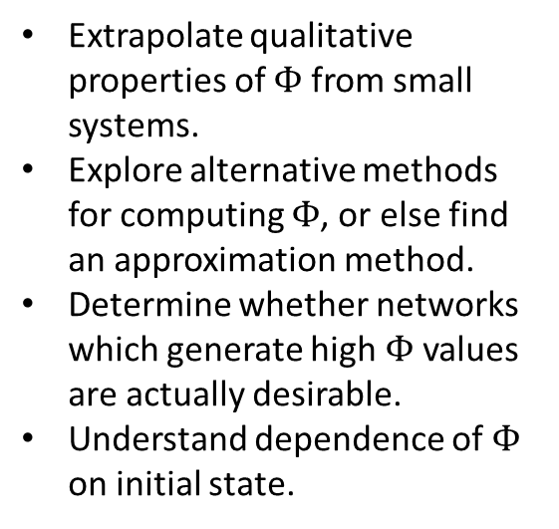
Future Work
Investigation of IIT
Development of Model
Extrapolate qualitative properties of $Φ$ from small systems.
Explore alternative methods for computing $Φ$, or else find an approximation method.
Determine whether networks which generate high $Φ$ values are actually desirable.
Understand dependence of $Φ$ on initial state.
Introduce notion of teams collaborating.
Add value to projects, and costs to the existence of teams and collaborations.
Allow the network two time scales over which it evolves.

